Slide 1

BRIDG Update
HL7 Working Group Meeting
Vancouver, BC, Canada
15 May 2012
Monday Q4, 3:30-5:00
Smita Hastak
(on behalf of BRIDG SCC)

Slide 2
Agenda
Recent Accomplishments
Current Efforts
Next Release of BRIDG
HL7 and ISO Ballot Status
RCRIM Harmonization Schedule
Next Steps

Slide 3
Recent Accomplishments
Released BRIDG 3.1 on February 29, 2012
  MD Anderson/National Marrow Donor Program (NMDP) Hematopoietic Cell Transplant (HCT) Database Common Data Elements (part 1)
  National Institute of Health (NIH) Clinical and Translational Science Award (CTSA) Human Studies Database (HSDB)
  NCI Case Report Form (CRF) Harmonization and Standardization Initiative (rounds 1 and 2)
Notes:
HCT: The main concepts that were harmonized in this round of the HCT elements are donor and recipient information. This project is taking a phased approach to harmonization, so additional concepts will be harmonized in subsequent releases of BRIDG.
CTSA HSDB: The main concepts harmonized from the HSDB model are limited to administrative components of human studies to facilitate standardization of data elements usage amongst various Institutional Review Board (IRB) and Clinical Trial Management Systems (CTMS) across organizations.
NCI CRF: The main concepts covered in the harmonization of the NCI CRFs include Registration, Enrollment, Participant Identifiers, Demography, Medical History, Physical Exam, Adverse Events, and Protocol Deviation. The NCI CRF project is taking a phased approach so additional concepts will be harmonized in subsequent releases of BRIDG.

Slide 4
Year | Release(s) | Projects Harmonized with BRIDG
2012 | 3.1 | NCI Hematopoietic Cell Transplant (HCT) Database Common Data Elements (part 1) NIH Clinical and Translational Science Award (CTSA) Human Studies Database (HSDB) NCI Case Report Form (CRF) Harmonization and Standardization Initiative (rounds 1 and 2)
2011 | 3.0.3 | CDISC Study Data Tabulation Model (SDTM) v3.1.2 CDISC Clinical Data Acquisition Standards Harmonization (CDASH) v1.1 CDISC Trial Design Model (TDM) v2 ISO JIC Ballot Comments HL7 Individual Case Safety Reporting (ICSR) Message
2010 | 3.0.2, 3.0.1 | NCI Clinical Trials Registration & Results (CTRR) CDISC Ballot Comments NCI Central Clinical Participant Registry (C3PR) v2.9 caBIG Adverse Event Reporting System (caAERS) v2.2 NCI LabViewer (LV) v2.2 NCI Patient Study Calendar (PSC) v2.6 ISO Ballot Comment Responses (part 1)
2009 | 3.0, 2.2 | CDISC HL7 Message Study Design (partial) CDISC HL7 Message Study Participation (Architecture Redesign)
2008 | 2.1, 2.0 | Adverse Events Player / Scoper for Person and Organization Clinical Trial Registry (COPPA, ct.gov, WHO, PRV1.0) NCI Central Clinical Participant Registry (C3PR) NCI Protocol Abstraction (COPPA (Correlations, Organizations, People, Protocol Abstraction))
2007 | 1.1, 1.0 | HL7 Regulated Product Submission (RPS) NCI Patient Study Calendar (PSC) NCI Clinical Trial Object Model (CTOM) NCI caXchange/LabHub CDISC Study Data Tabulation Model (SDTM) v3.1.1 CDISC Trial Design Model (TDM) v1.0

Slide 5
Current Efforts
(between now and next release)
Harmonization of:
  MD Anderson/National Marrow Donor Program (NMDP) Hematopoietic Cell Transplantation (HCT) project (part 2)
    Continuing to add bone marrow/stem cell transplant concepts to BRIDG
    CDISC Statistics Domain Analysis Model
    HL7 Clinical Trials Registration & Results (CTRR) R3
    FDA Clinical Trial Repository (CTR) model
Internal efforts
  Updating BRIDG website
  Managing enhancement requests provided by community via GForge
  Creating a script to automatically add mapping tags from mapping spreadsheet to EAP file

Slide 6
Next Release of BRIDG
Slated for August 2012
Will include:
  MD Anderson/National Marrow Donor Program (NMDP) Hematopoietic Cell Transplantation (HCT) project (part 2 - complete)
  NCI Case Report Form (CRF) Standard Elements (Round 3 of 4)
  CDISC Statistics model
  HL7 Clinical Trials Registration and Results (CTR&R) R3
  FDA Clinical Trial Repository (CTR) Model
  NCI Clinical Trials Reporting Project (CTRP)
  HL7 ISO JIC Comments

Slide 7
RCRIM BRIDG Re-Publishing
BRIDG 3.1 needs to be published in HL7
  Slated for September 2012 ballot

Slide 8
ISO Ballot Status
The BRIDG New Work Item Proposal approved for publication in June for 60 days (approved at May 2012 ISO meeting)
Next round of ISO Balloting – need 6 months lead time – 1 month for ISO HQ to review/prepare ballot and 5 months for the Draft International Standard (DIS) ballot.
The next ballot will be a “fast-track” ballot, which means it is a thumbs up / down vote with no comments.
ISO does not have a set balloting schedule like HL7 does, but we try to align with a TC 215 Spring or Fall meeting so the ballot can be discussed in person.
The HL7 ballot needs to end at roughly the same time as the ISO ballot.
Need to determine ballot dates – rough estimates below:
  ISO JIC BRIDG NWIP published in June for 60 days (closes in August 2012)
  ISO JIC DIS ballot goes to ISO headquarters in August 2012
  ISO JIC DIS ballot is published by ISO HQ in September 2012 for 5 months
  ISO JIC DIS ballot closes in March 2013
  HL7 ballot opens April 2013 for May 2013 ballot? Issue: This ballot closing is not quite at the same time as the ISO JIC ballot. The JIC rule of thumb is to have ballot closings about the same time (1-2 weeks?)

Slide 9
BRIDG as a DAM Project
(Scope Statement Being Updated)
Harmonization schedule is being worked on to determine harmonization dates with project teams
  Mitra Rocca is working with all FDA projects on RCRIM project list
  Julie E is working with CRFQ
Important: Teams need to understand what it means to be ready to harmonize with BRIDG. See Harmonization Process Package on BRIDG website: www.bridgmodel.org.
  Teams need to prepare a harmonization request form
  Teams need to prepare a DAM if new semantics
  Teams need to prepare a mapping spreadsheet
  The BRIDG SCC assigns a Point of Contact as soon as a harmonization request form is received. This POC works with the project team.

Slide 10
BRIDG as a DAM - Scope Stmt
BRIDG Harmonization Schedule
Standard or Planned Message | RCRIM Status | Currently in BRIDG? | Date to Ballot in BRIDG
ISO JIC Ballot, including HL7 ballot | Not applicable | NA | Sep-2012
ANSI/HL7 Regulated Product Submission, R1-2008 | Approved Normative | Yes
HL7 V3 Standard: Regulated Product Submission, R2 | Current Project | No | TBD
HL7 CDISC to HL7 Message Study Design, R1 | Being withdrawn? | Yes (partial) | NA
HL7 Study Design Structured Document, R1 | Current Project | No | TBD
HL7 CDISC to HL7 Message Study Participation, R1 | Current Project | Yes (updates needed) | TBD
HL7 CDISC to HL7 Message Subject Data, R1 | Being withdrawn? | No | NA
HL7 Implementation Guide for CDA Release 2: Exchange of Clinical Trial Subject Data; Patient Narratives, R1 | Balloting as DSTU | No | TBD
Periodic Reporting of Clinical Trial Laboratory Data, R2 | Withdrawn | NA | NA
Laboratory Test Result Abnormality Assessment | Approved DSTU | Yes
Clinical Trial Registration and Reporting (CTR&R), R1 | DSTU | Yes | NA
Clinical Trial Registration and Reporting (CTR&R), R2 | 3 year plan | No | TBD
ANSI/HL7 V3 ECG, R2 | 3 year plan – wait for R2 | No | TBD
HL7 Drug Stability Reporting (eStability), R2 | Normative | No | TBD
HL7 Structured Product Label, R5 | DSTU | No | TBD
HL7 V3 CRFQ,R1 (extended DSTU – part of a trial, but DSTU expires before the trial does – will re-ballot in Jan 2012 to get it re-affirmed as DSTU Release 2 with no changes) | Approved DSTU | No | TBD

Slide 11
Next Steps
(July thru December 2012 - after August 2012 Release)
Harmonization of:
  LSDAM, Genzyme’s RegistryNXT!, NCI Imaging projects, CDISC SDTM and Study Design Update
Update BRIDG as a DAM Harmonization Process Document
  Exploring the generation of an OWL representation of BRIDG

Slide 12
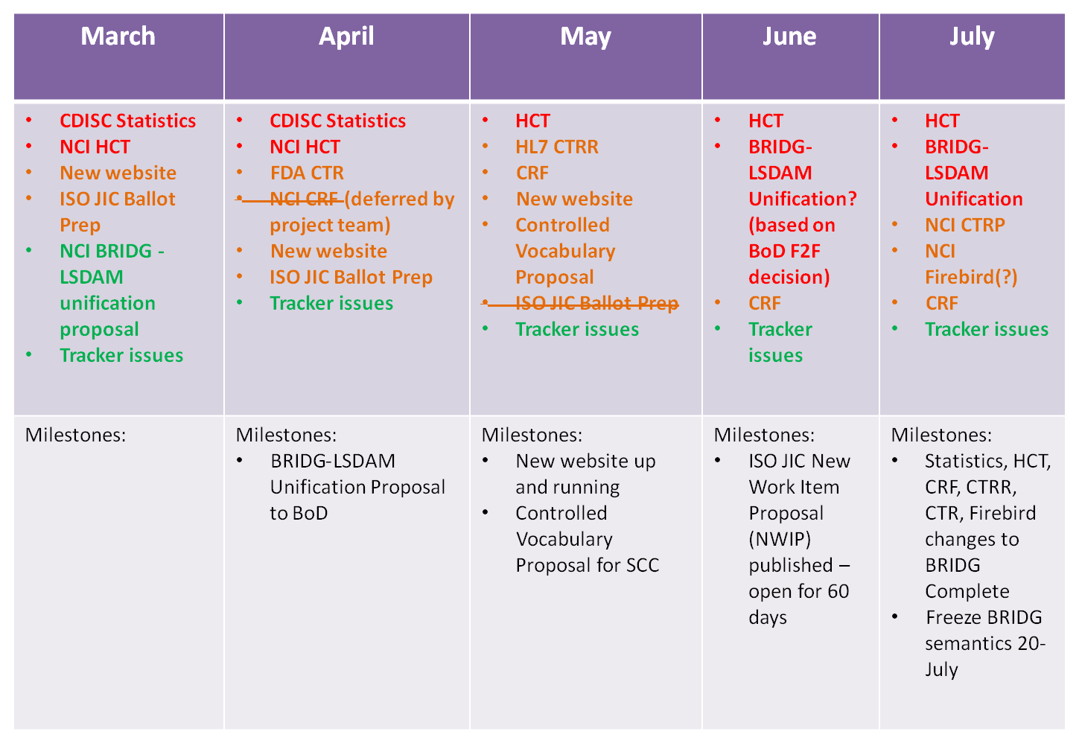
BRIDG SCC Proposed Schedule – 2012 Q1 and Q2 based on priority and readiness for harmonization
Level of Effort:
Large
Medium
Small
TBD

Slide 13
BRIDG SCC Proposed Schedule – 2012 – Q3 & Q4 based on priority and readiness for harmonization
August | September | October | November | December
BRIDG-LSDAM Unification Release 3.2 Prep ISO JIC Ballot Prep Tracker issues | NCI Imaging – AIM - TBD BRIDG-LSDAM Unification Genzyme’s RegistryNXT! Tracker issues | NCI Imaging – NBIA - TBD BRIDG-LSDAM Unification CDISC SDTM Update Tracker issues | CDISC Study Design Update ISO JIC Ballot Comment Resolution Tracker issues | ISO JIC Ballot Comment Resolution Tracker issues
Milestones: Release 3.2* - end of August ISO JIC New Work Item Proposal (NWIP) closed Re-publish in HL7 Ballot | Milestones: BRIDG-LSDAM Unification ISO JIC Draft International Standard (DIS) ballot goes to ISO HQ | Milestones: | Milestones: ISO JIC DIS Ballot opens for 5 months when ISO HQ publishes it | Milestones:
*Release 3.2 planned new semantics: Stats, HCT, CRF, CTRR, CTR, CTRP, Firebird
**Release 4.0 in Jan 2013 based on all the new semantics added in 2nd half of 2012
(Genzyme, AIM, NBIA, CDISC Study Design, CDISC SDTM Update)

Slide 14
BRIDG Semantic Coordination Committee (SCC)
Name | Affiliation
Becky Angeles | NCI / ScenPro, Inc.
Julie Evans | CDISC
Smita Hastak | NCI / ScenPro, Inc.
Charlie Mead | NCI
Lloyd McKenzie | NCI / Gordon Point Informatics
Wendy Ver Hoef | NCI/ ScenPro, Inc.

Slide 15
BRIDG Board of Directors
Appointed Members | Stakeholder
Charlie Mead | NCI
Wayne Kubick | CDISC
Chuck Jaffe | HL7
Jonathan Levine | FDA
At Large Members | Term Expiration
Cecil Lynch | 2012
Abdul-Malik Shakir | 2012
Sue Dubman | 2013
John Speakman | 2013
Diane Wold | 2013
Jack Jones** | 2014
Becky Kush* | 2014
* Chair
** Chair Elect
Mitra Rocca | FDA Ex Officio

Slide 16
Contact Information
BRIDG Project Website
  www.bridgmodel.org
SCC Contact Listserv
  bridgTHC-L@list.nih.gov
BRIDG Users Listserv
  BRIDG_USERS@list.nih.gov
RCRIM: BRIDG as a DAM Listserv
  bridg@lists.hl7.org

Slide 17
Q & A

Slide 18

Back up slides

Slide 19




BRIDG Overview
BRIDG Purpose:
A collaborative effort to produce a shared view of the dynamic and static semantics that collectively define a shared domain-of-interest.
Stakeholders:
Process:
Board of Directors prioritizes projects and Semantic Coordination Committee consults with projects and harmonizes project models into main model with help of project analysts/SMEs

Slide 20
BRIDG Domain-of-interest/scope
Protocol-driven research and its associated regulatory artifacts
  i.e. the data, organization, resources, rules, and processes involved in the formal assessment of the utility, impact, or other pharmacological, physiological, or psychological effects of a drug, procedure, process, subject characteristic, biologic, cosmetic, food or device on a human, animal, or other subject or substance plus all associated regulatory artifacts required for or derived from this effort, including data specifically associated with post-marketing adverse event reporting.

Slide 21
Release | Date | Projects Harmonized with BRIDG | Stakeholder
3.1 | Feb 2012 | Hematopoietic Cell Transplant (HCT) Database Common Data Elements (part 1) | NCI
 |  | National Institute of Health (NIH) Clinical and Translational Science Award (CTSA) Human Studies Database (HSDB) | NCI, NIH
 |  | NCI Case Report Form (CRF) Harmonization and Standardization Initiative (rounds 1 and 2) | NCI
3.0.3 | Dec 2011 | SDTM v3.1.2, CDASH v1.1, TDM, ISO JIC Ballot Comments | CDISC
 |  | HL7 ICSR Message | FDA, HL7
3.0.2 | Aug 2010 | Central Clinical Participant Registry (C3PR), caBIG Adverse Event Reporting System (caAERS), LabViewer (LV), Patient Study Calendar (PSC) | NCI
 |  | ISO Ballot Comment Responses (part 1) | CDISC
3.0.1 | Feb 2010 | Clinical Trials Registration & Results, CDISC Ballot Comments | HL7 RCRIM, CDISC
3.0 | Oct 2009 | (Architecture Redesign only)
2.2 | May 2009 | CDISC HL7 Message Study Design (partial), CDISC HL7 Message Study Participation | FDA
2.1 | Oct 2008 | Clinical Trial Registry (COPPA, ct.gov, WHO, PRV1.0) | CDISC, NCI
 |  | Protocol Abstraction (COPPA – Correlations, Organizations, People and Protocol Abstraction) | NCI
2.0 | Jun 2008 | Adverse Events | CDISC, NCI, NIH, US Federal Gov’t, FDA
 |  | Player / Scoper for Person and Organization | NCI, CDISC
 |  | Patient Registry (C3PR) | NCI
1.1 | Oct 2007 | Study Data Tabulation Model (SDTM), Trial Design Model (TDM) | CDISC
1.0 | Jun 2007 | Regulated Product Submission (RPS) | FDA, HL7 RCRIM
 |  | Patient Study Calendar (PSC), Clinical Trial Object Model (CTOM) | NCI
 |  | caXchange/LabHub | NCI, HL7 RCRIM, CDISC

